Slide 1
Hackathon Report 2
Name –Samyak Jain
Code – GSBSP-BR-43

Slide 2
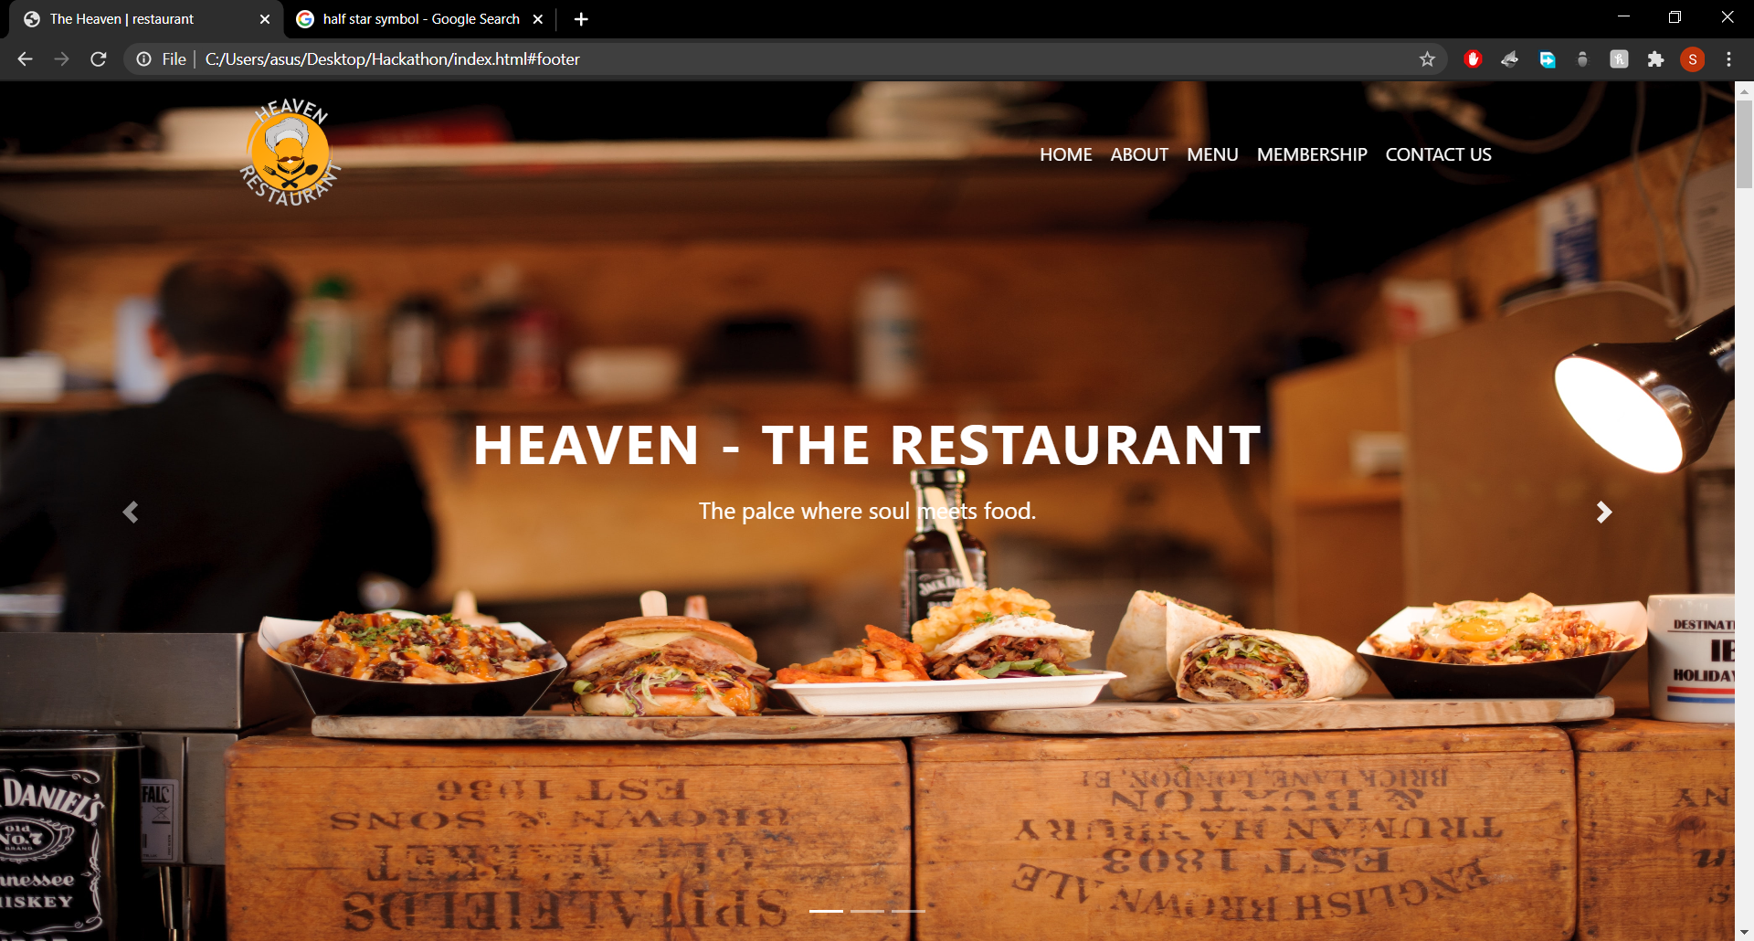
Added logo of the Restaurant, but work on fonts still left.

Slide 3
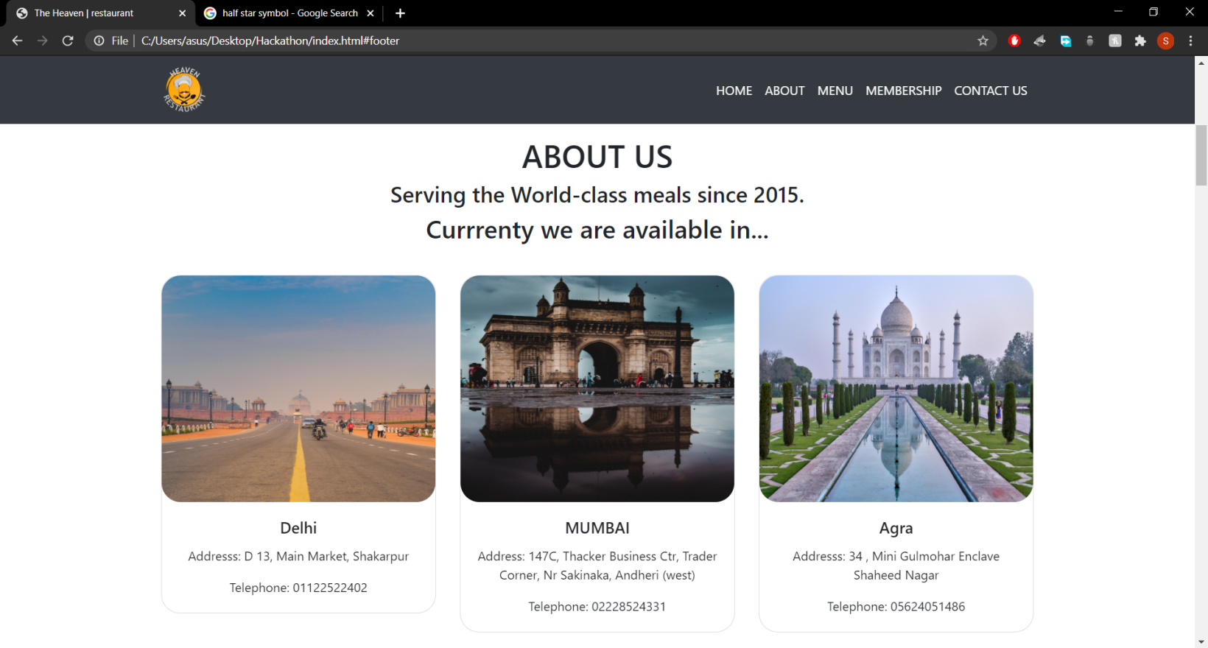
Added “ABOUT US” section along with the business places

Slide 4
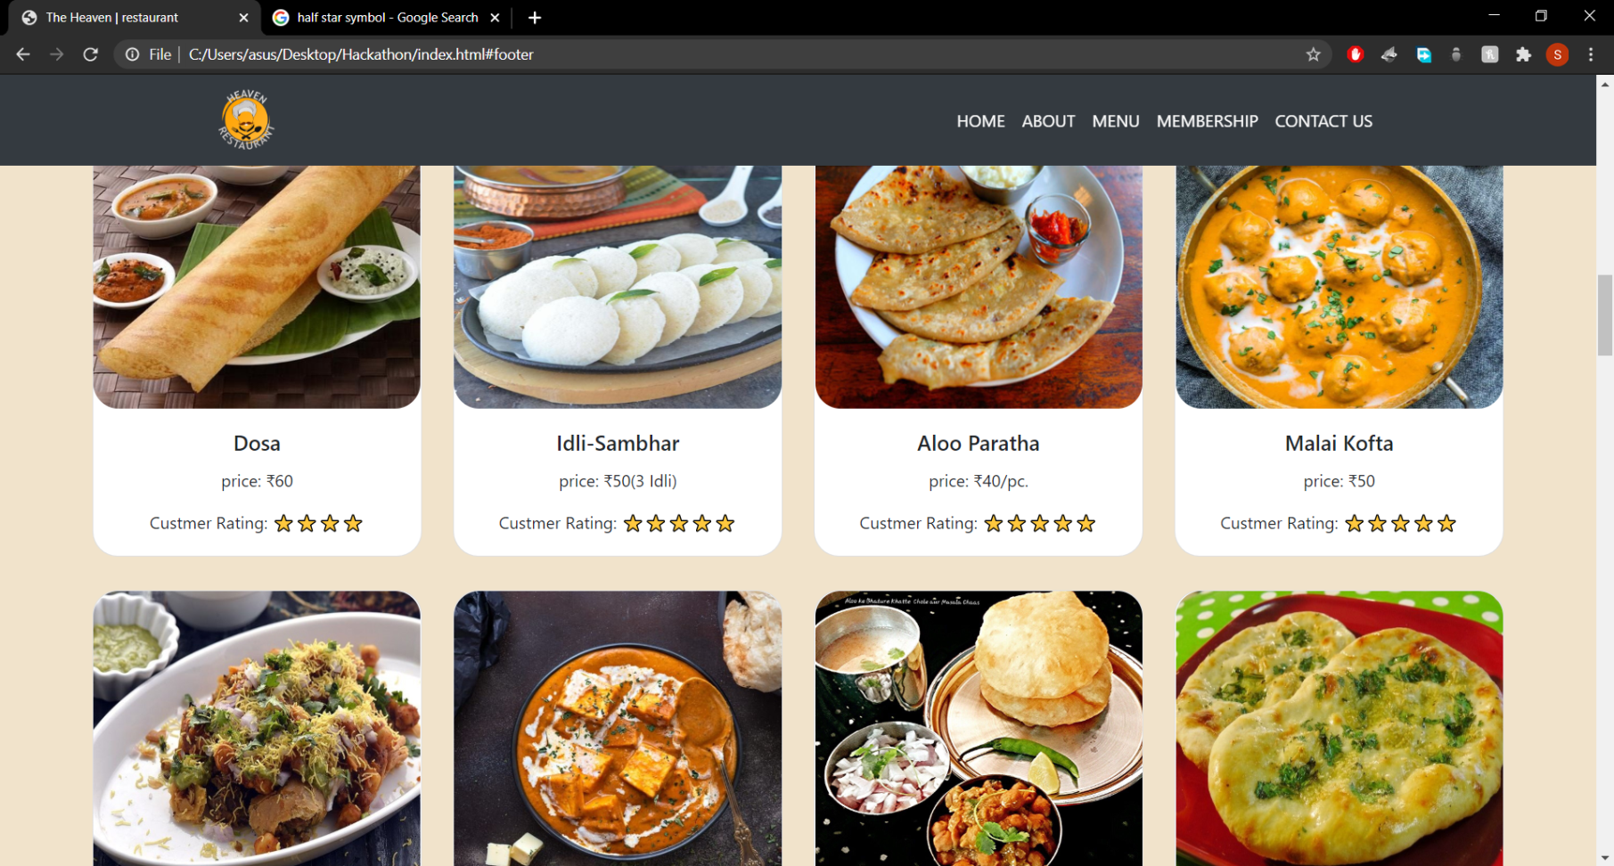
Added names and price of the dishes with the ratings(with correct images).

Slide 5
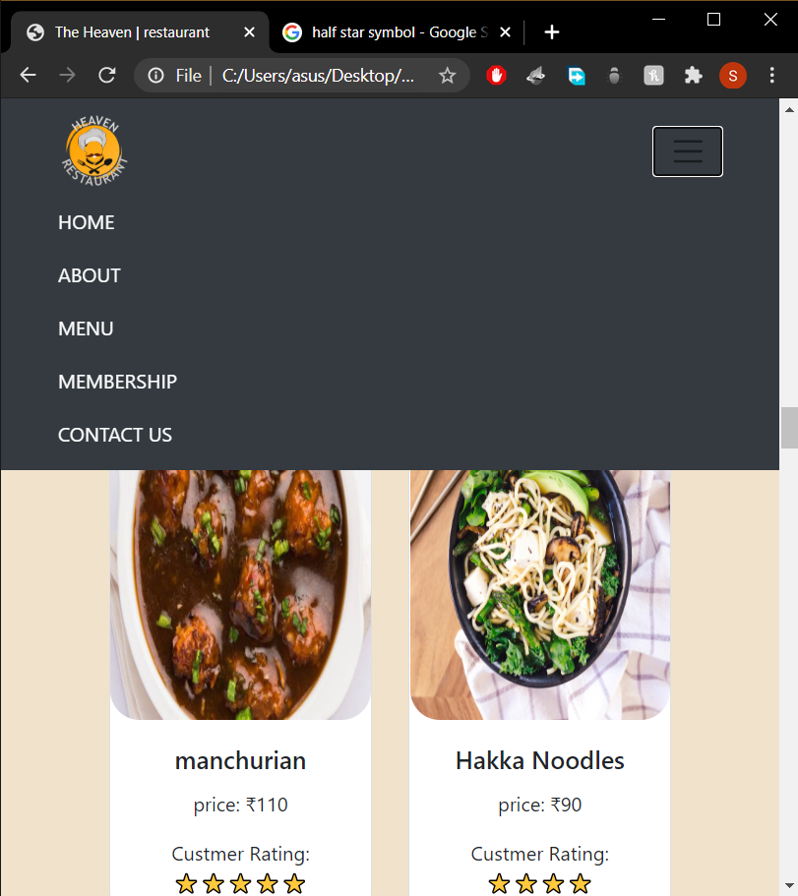
Responsiveness still maintained.

Slide 6
Looking Further For….
Adding some good fonts and styles to the writing section.
Adding JavaScript animations.
Adding effects like scrolling(while click on links)

Slide 7
THANK YOU!!
IF THERE IS ANY ISSUE PLEASE TELL ME.

